Slide 1




Astronomy 1010 chapter 3
Clayton State University
Slides for Astronomy textbook from OpenStax
https://openstax.org/books/astronomy/

Slide 2
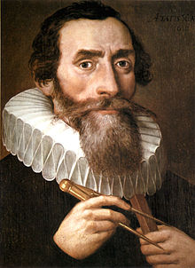
Johannes Kepler
Received an-invitation from Tycho Brahe In December of 1599 to come to Denmark and work with him. Kepler seized the opportunity and, after Brahe's death, used Brahe's very precise observation data concerning Mars, to discover why Copernicus' model had problems predicting planetary motion any more accurately than Ptolemy's. He also did observations of his own of the motions of Mars, Venus and Mercury. His conclusions were as simple as they were elegant: the planets did not move in circular orbits! They moved in elliptical ones. Kepler had done what neither Ptolemy, Copernicus nor Tycho Brahe had been able to do--free models of the Universe from the tyranny of the circle. This First Law of Planetary Motion, arrived at in 1604, enabled the Copernican system to accurately predict the movement of the planets and, more importantly, removed the major scientific objection to its validity.
It is ironic that in completing his work in astronomy, Kepler destroyed the framework of his other pursuit, astrology. Throughout his life he was to show no hesitation in his support of the Copernican system. Kepler also encouraged other mathematicians and astronomers to come out in support of the sun centered Universe as well. Among these was an obscure Italian named Galileo Galilei.

Slide 3
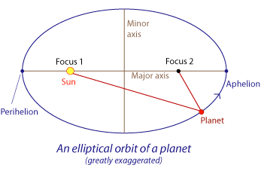
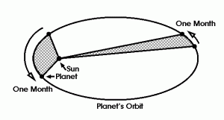
Kepler’s laws
1 Kepler’s First Law states that planets move around the Sun in an elliptical orbit with the Sun at one focus of the ellipse.
  (property of the ellipse – sum of two red lines is always constant)
2 Kepler’s 2nd Law: The line from the Sun to a planet sweeps out equal areas (in grey) in equal times.

Slide 4
Kepler’s laws
3 What Kepler discovered, to be exact, is that the square of the orbital period (T) of a planet is directly proportional to the cube of the semi-major axis of its orbit (a)
              T² ~ a³
planets move slower when they’re farther from the Sun, and whatever influence makes planets go around the Sun weakens with distance. It was left to the great British scientist and world-historical genius, Isaac Newton, to explain this relationship with his own law of gravity
Kepler’s three laws appear to hold not just in our own solar system, but in all circumstances where one body moves under the influence of another’s gravity. They are general universal relationships.

Slide 5
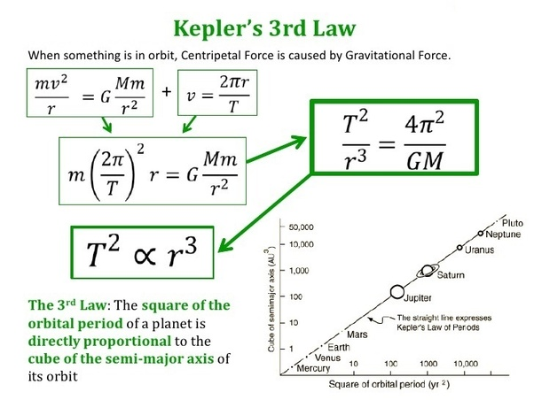
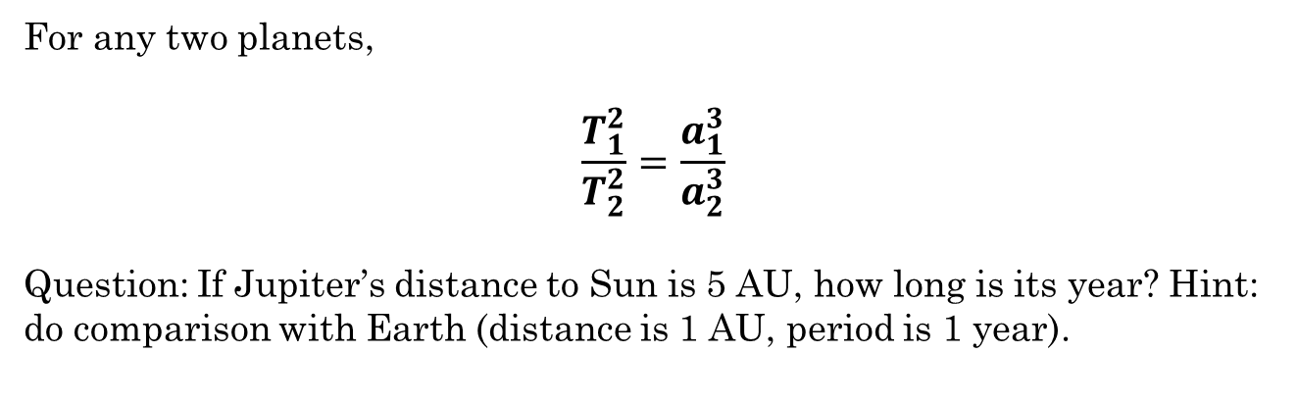
Kepler’s 3rd law in practice
For any two planets,
$$\frac{T_{1}^{2}}{T_{2}^{2}}=\frac{a_{1}^{3}}{a_{2}^{3}}$$
Question: If Jupiter’s distance to Sun is 5 AU, how long is its year? Hint: do comparison with Earth (distance is 1 AU, period is 1 year).

Slide 6
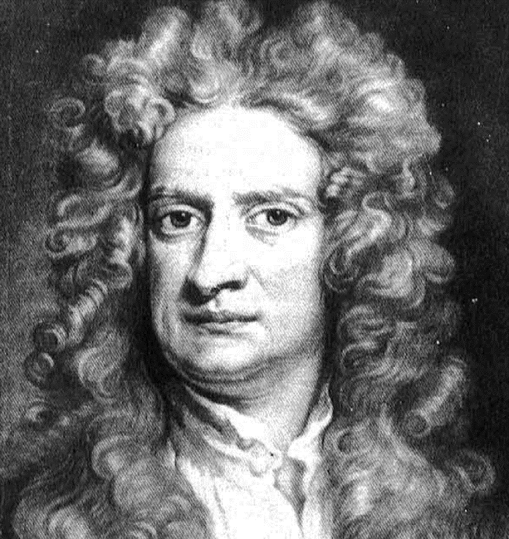
Isaac Newton
Sir Isaac Newton (25 December 1642 – 20 March 1726/27) was an English mathematician, physicist, astronomer, theologian, and author (described in his own day as a "natural philosopher") who is widely recognized as one of the most influential scientists of all time, and a key figure in the scientific revolution.
His book Philosophiæ Naturalis Principia Mathematica ("Mathematical Principles of Natural Philosophy"), first published in 1687, laid the foundations of classical mechanics. Newton also made seminal contributions to optics, and shares credit with Gottfried Wilhelm Leibniz for developing the infinitesimal calculus.
For more interesting facts, check out:
  http://mentalfloss.com/article/24520/6-things-you-should-know-about-isaac-newton

Slide 7
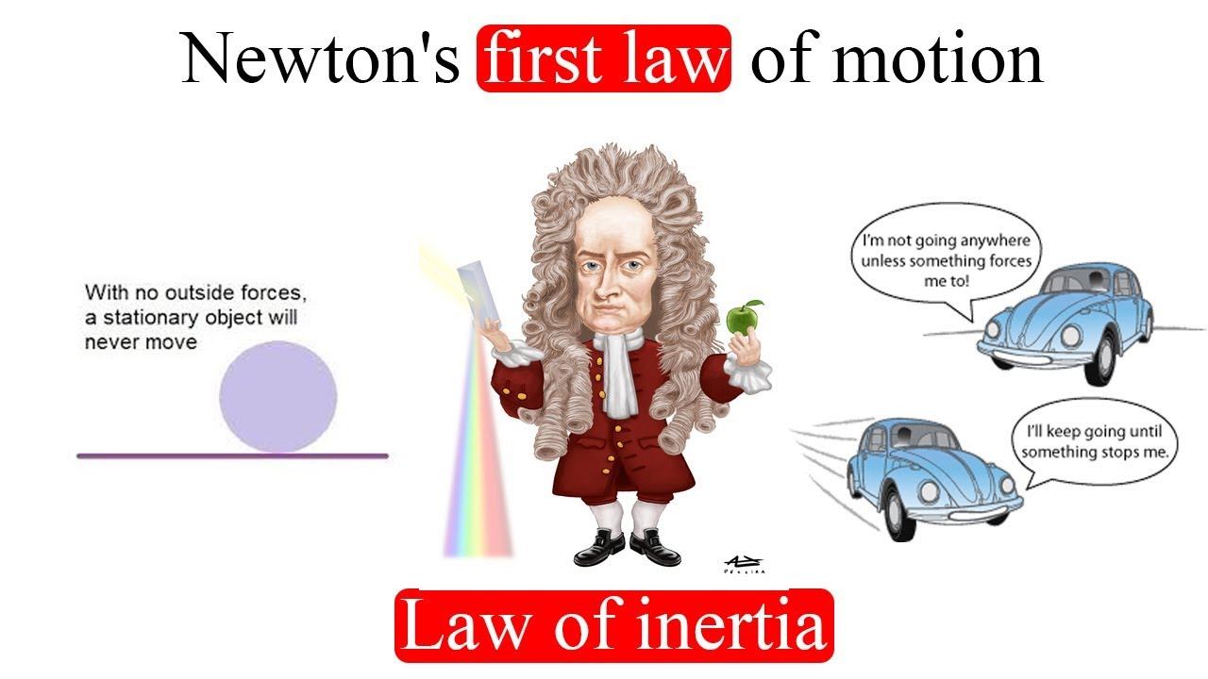
Newton’s Laws
Net zero force – can all be balanced.
Inertial reference frame – stationary or moving without acceleration – no external forces.

Slide 8
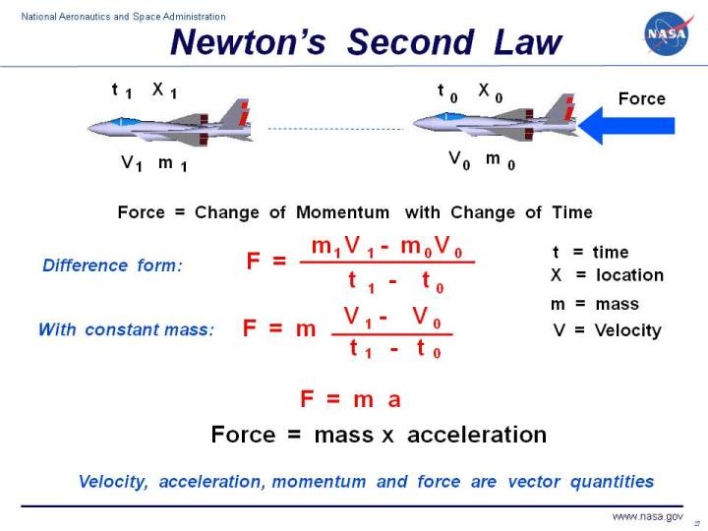
Newton’s Laws
Where mass is just a proportionality constant. Its inertial mass, NOT weight!

Slide 9
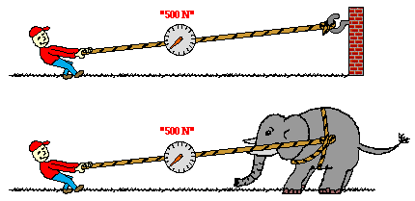
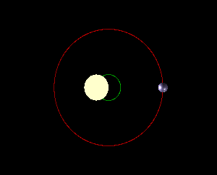
Newton’s Laws
3rd law: Every action causes equal and opposite reaction
Consequence: not only star attracts the planets, but the planets affect the motion of the Sun as well. Thus, Sun and planets orbit the common center of mass of the Solar system (Barycenter)
Adopter from: https://spaceplace.nasa.gov/barycenter/en/

Slide 10
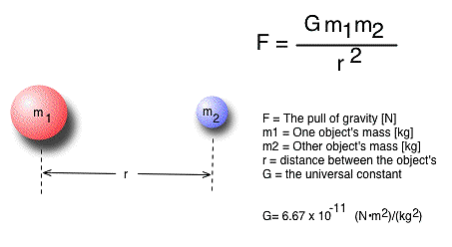
Newton’s Laws
Universal law of gravity

Slide 11
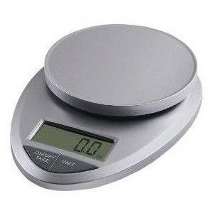
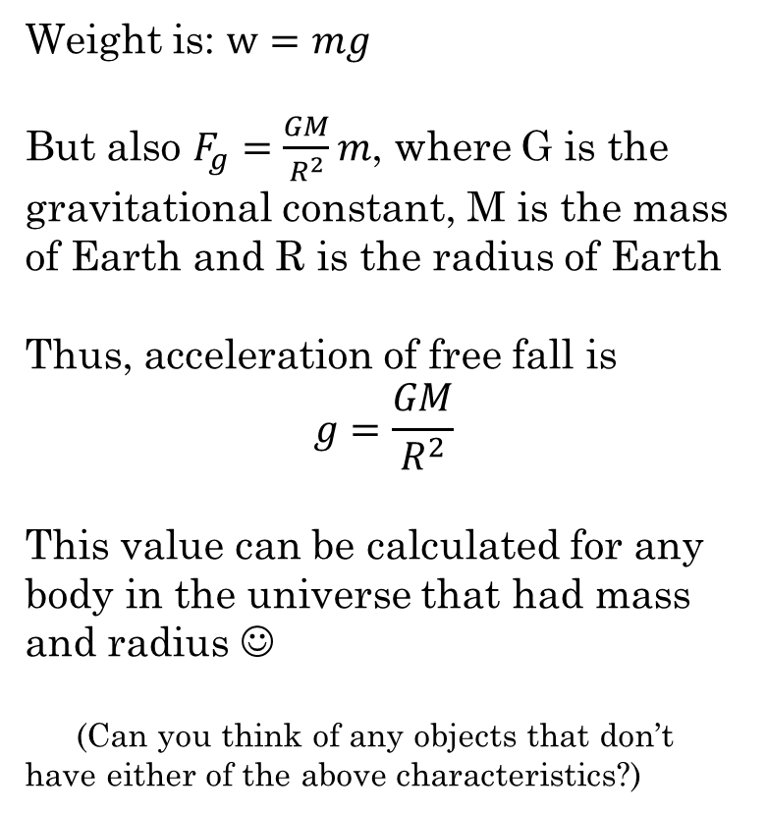
What about g?
Weight is: $w=mg$
But also $F_{g}=\frac{GM}{R^{2}}m$, where G is the gravitational constant, M is the mass of Earth and R is the radius of Earth
Thus, acceleration of free fall is
$$g=\frac{GM}{R^{2}}$$
This value can be calculated for any body in the universe that had mass and radius ☺
(Can you think of any objects that don’t have either of the above characteristics?)

Slide 12
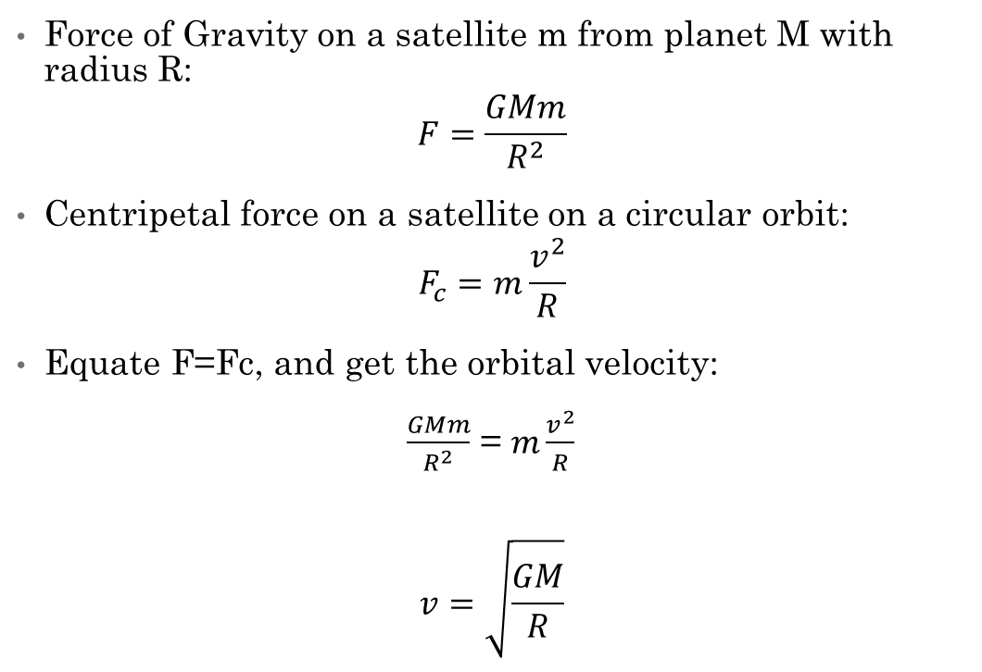
Orbital Speed
Force of Gravity on a satellite m from planet M with radius R:
$$F=\frac{GMm}{R^{2}}$$
Centripetal force on a satellite on a circular orbit:
$$F_{c}=m\frac{v^{2}}{R}$$
Equate F=Fc, and get the orbital velocity:
$\frac{GMm}{R^{2}}$ = $m\frac{v^{2}}{R}$
$$v=\sqrt{\frac{GM}{R}}$$

